Slide 1
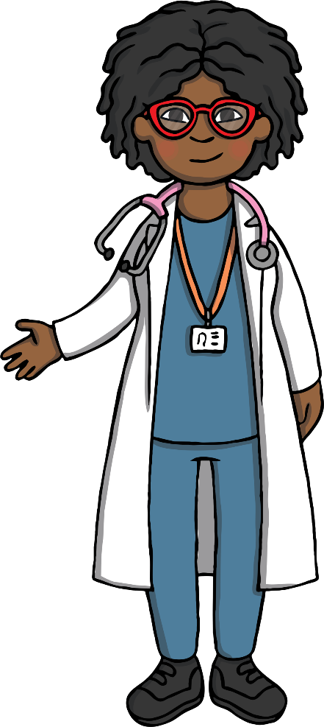
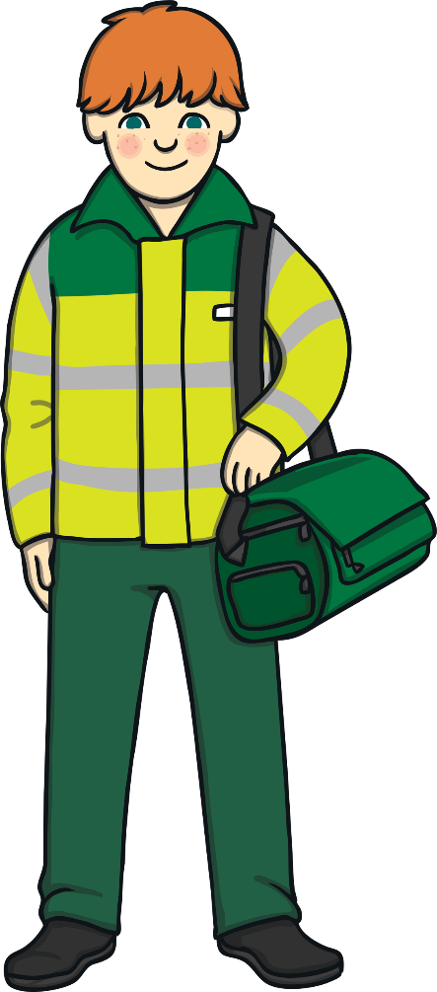
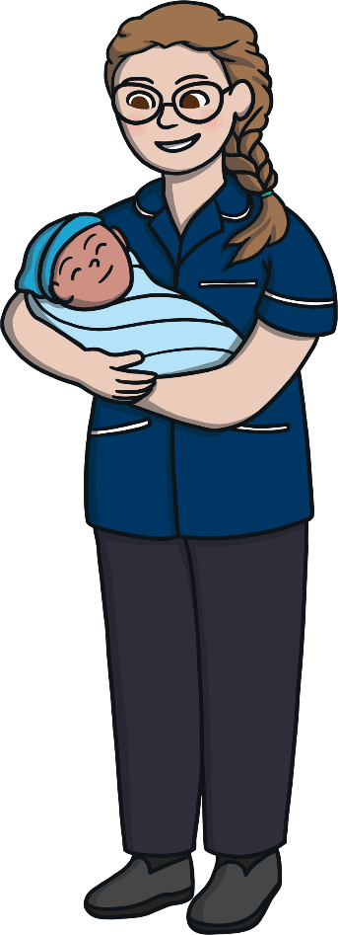

Slide 2
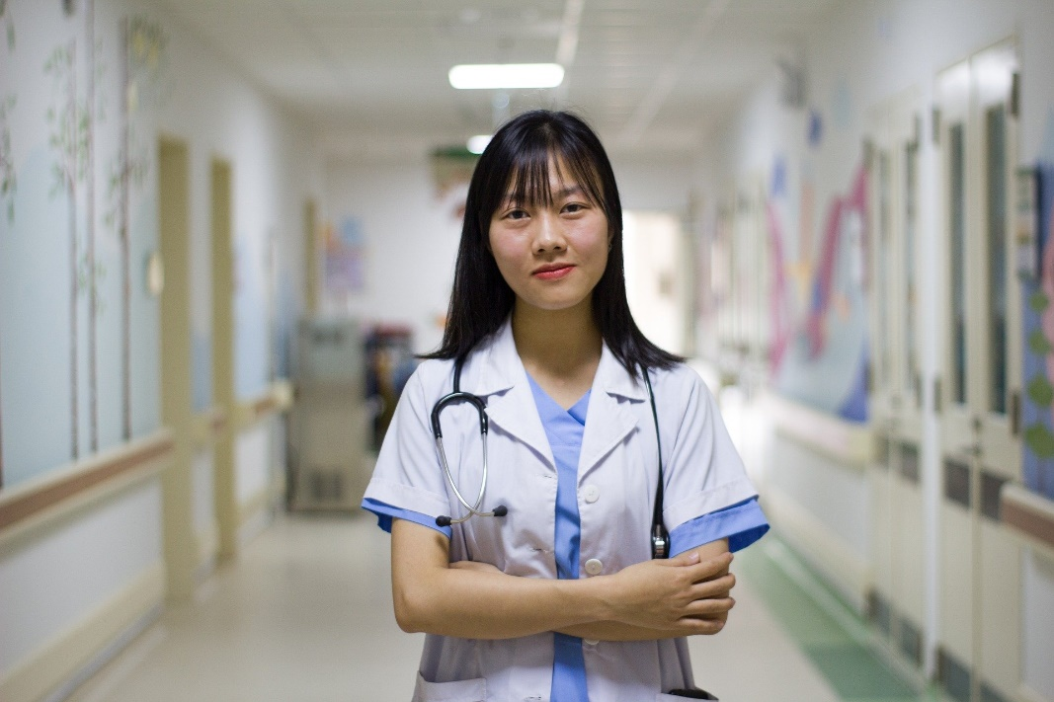
What Is the NHS?
The NHS stands for the National Health Service in the UK.
People who work in the NHS keep people healthy. They help us when we’re feeling poorly or are hurt.

Slide 3
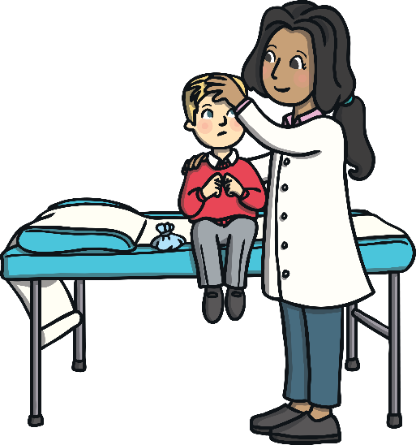
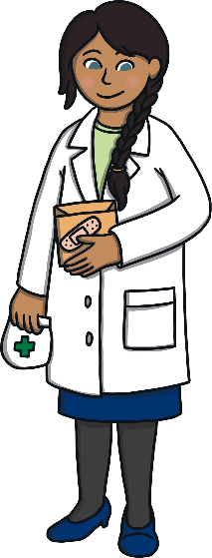
When Do We Use the NHS?
Think about times when you have been helped by someone who works for the NHS.
Who helped you when you were hurt?
Who gave you medicine when you were poorly?
Who would you phone if you needed medical help in an emergency?

Slide 4
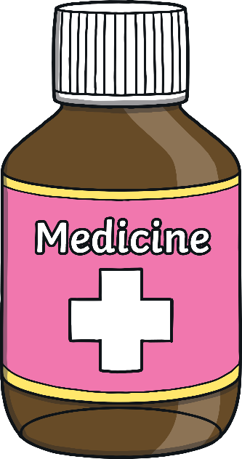
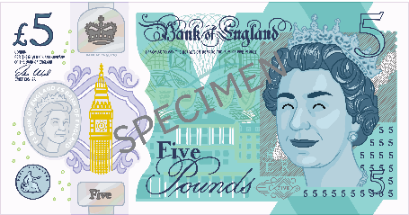
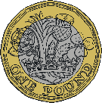
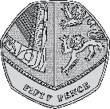
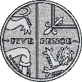
Life Before the NHS
The UK hasn’t always had a National Health Service.
Before having the NHS, only very rich people could afford to go to hospital or get medical help.
Seeing a doctor used to cost a lot of money. If the person did not have enough money, they did not get the medicine or the help.

Slide 5
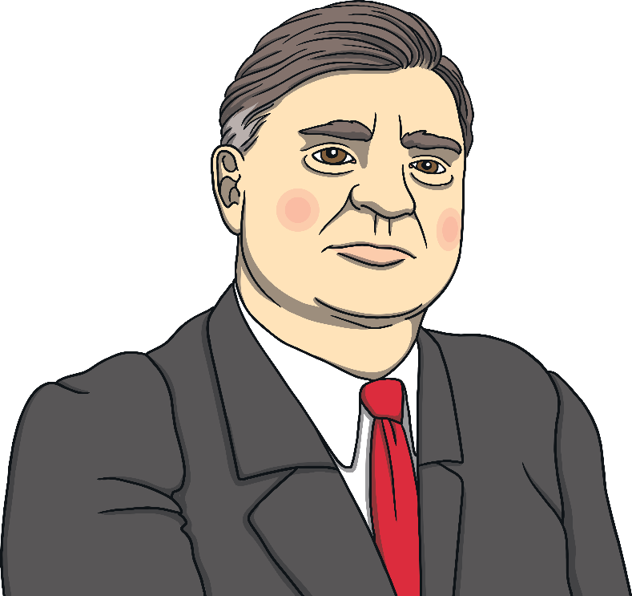
Aneurin Bevan
Aneurin Bevan decided to change things. He wanted everyone to be able to get help when they were ill or injured.
Aneurin Bevan was from Wales.
He worked for the government.
After the Second World War, he was chosen to be in charge of health in the UK. His job was to think about how to keep everyone healthy.

Slide 6
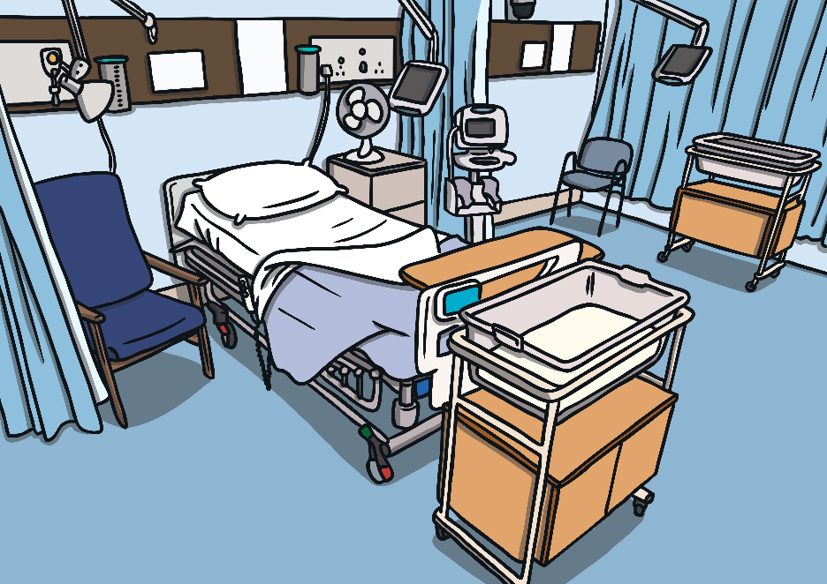
Aneurin Bevan
Aneurin Bevan started the National Health Service on 5th July 1948.
He wanted medical care to be free for everyone in the UK.
This meant that it did not matter whether people had lots of money or not - everyone could get treated and helped.

Slide 7
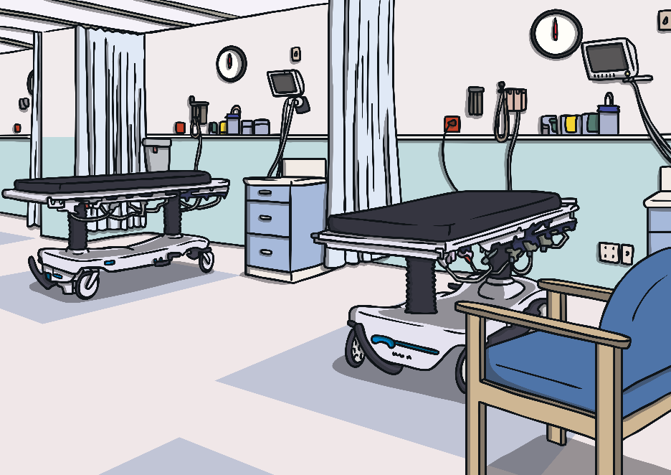
How Does It Work?
Every person in the United Kingdom can get medical help when they need it, without paying a bill.
The UK has a special system for collecting money to pay for this.
Every grown-up with a job pays something called taxes. This is money that they pay to the government each month.
The money from taxes is shared out by the government. Some of the money is given to the NHS to pay for the staff, the buildings and the equipment.

Slide 8
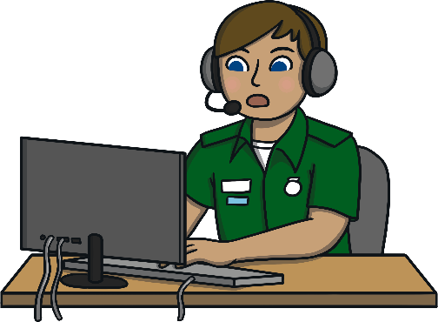
NHS Staff
There are many different people who work in the NHS.
Every single person is important for the NHS to work together to keep
us well.
people who answer 999 calls
doctors
Lots of people are needed to answer the telephone for when people call 999. They work out what help is needed and send the right person.
Doctors see poorly patients in doctor’s surgeries and hospitals. They work out what’s wrong. They might perform operations.
nurses
paramedics
Nurses care for poorly patients. They might take your temperature, clean a wound or give you an injection.
Paramedics help at emergencies when someone calls 999. They give people first aid and use an ambulance to get them to a hospital quickly.

Slide 9
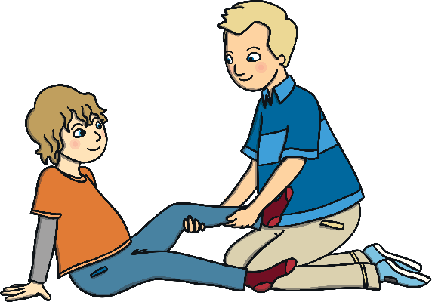
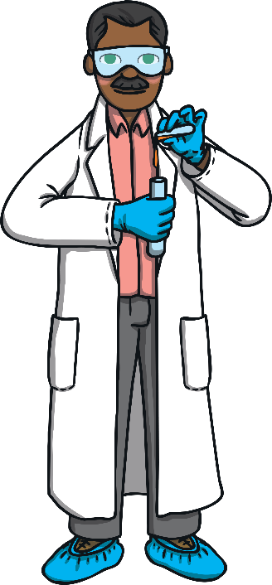
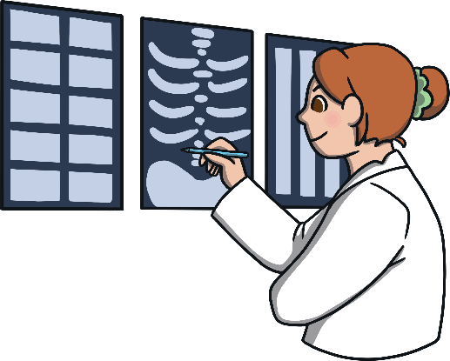
NHS Staff
There are many different people who work in the NHS.
Every single person is important for the NHS to work together to keep
us well.
dental team (dentists, dental nurses, office staff)
physiotherapists
Staff at a dental surgery keep your teeth healthy. A dental nurse might clean your teeth. A dentist might give your tooth a filling or even take a tooth out.
Physiotherapists help people get their body working after an illness or injury. They might help you learn to walk again after an accident.
health informatics
healthcare scientists
Health informatics get facts to the right people at the right time. They help other people make decisions about how to stop diseases spreading or how to help people.
NHS scientists look for ways to help save lives and make lives better through research.

Slide 10
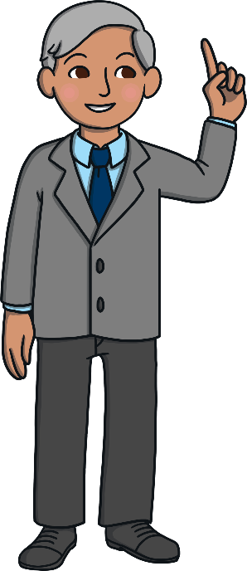
NHS Staff
There are many different people who work in the NHS.
Every single person is important for the NHS to work together to keep
us well.
management
pharmacists
The NHS managers have to make sure the system runs smoothly. They work out how to spend money, how many people are needed to work at each hospital, and more.
Pharmacists get medicine ready for people who are poorly. They give people advice on taking the right medicine to get better.
midwives
Midwives look after pregnant women. They help to deliver the baby and to keep the mum and baby healthy afterwards.

Slide 11
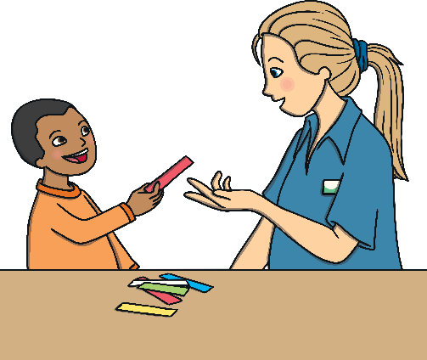
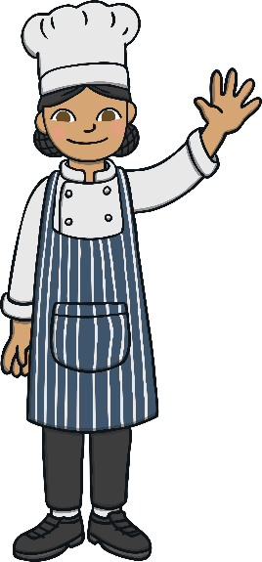
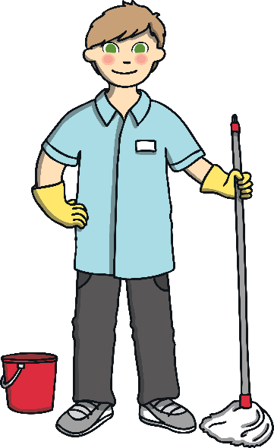
NHS Staff
There are many different people who work in the NHS.
Every single person is important for the NHS to work together to keep
us well.
public health team
mental health workers
The public health team are in charge of making sure that we know how to live healthy lives and what to do if we are unwell.
These NHS workers support people’s minds and help them if they feel really sad or worried.
Did you know
about all these different jobs within the NHS?
wider healthcare team
Which jobs were new to you?
There are lots of people needed to make the NHS work, such as cleaners, porters, chefs, building staff and more.

Slide 12
What is PPE
P
Personal
Why is PPE important for the NHS?
P
Protective
PPE is important to keep NHS workers safe in the workplace or on home visits when they might be near people who could have harmful germs. Healthcare workers might need to use special equipment, follow special rules or instructions or have someone work with them to make sure they are safe.
E
Equipment

Slide 13
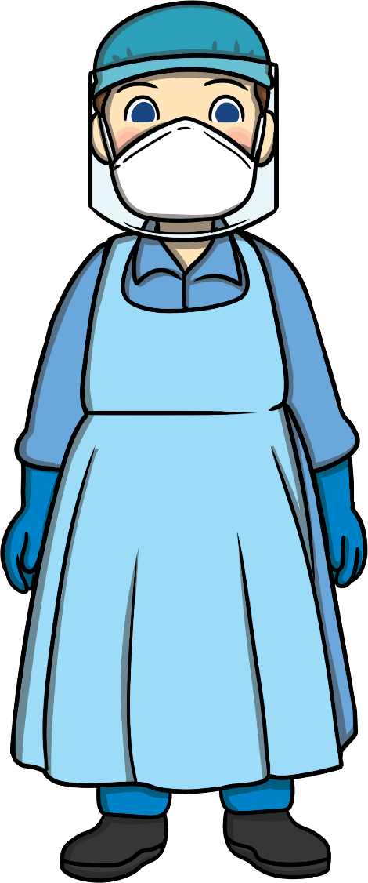
Types of PPE
Eyes
If needed, safety glasses, goggles or a face shield might be worn to stop objects or bacteria going into the eyes.

Slide 14
Types of PPE
hands and arms
If needed, gloves or sleeves that cover part or all of the arm might be worn to stop risks such as hot or cold temperatures, chemicals, radiation or bacteria harming the skin.

Slide 15
Types of PPE
lungs
If needed, a filtered facepiece or a respirator might be worn to stop the wearer breathing in dangerous gases, dust or bacteria.
It’s important to remember that these must be filtered.

Slide 16
Types of PPE
Whole body
If needed, aprons, boiler suits or overalls can be worn to stop heat, unclean liquid, dust or harmful objects touching the body.

Slide 17
NHS Quiz!
No, the NHS is made up of people doing many different important jobs.
Are doctors and nurses the only people who work for the NHS?
National Health Service
What does NHS stand for?
The NHS
What did Aneurin Bevan create?
Pay money for it.
Before the NHS, what did people have to do if they needed help or medicine?

