Slide 1
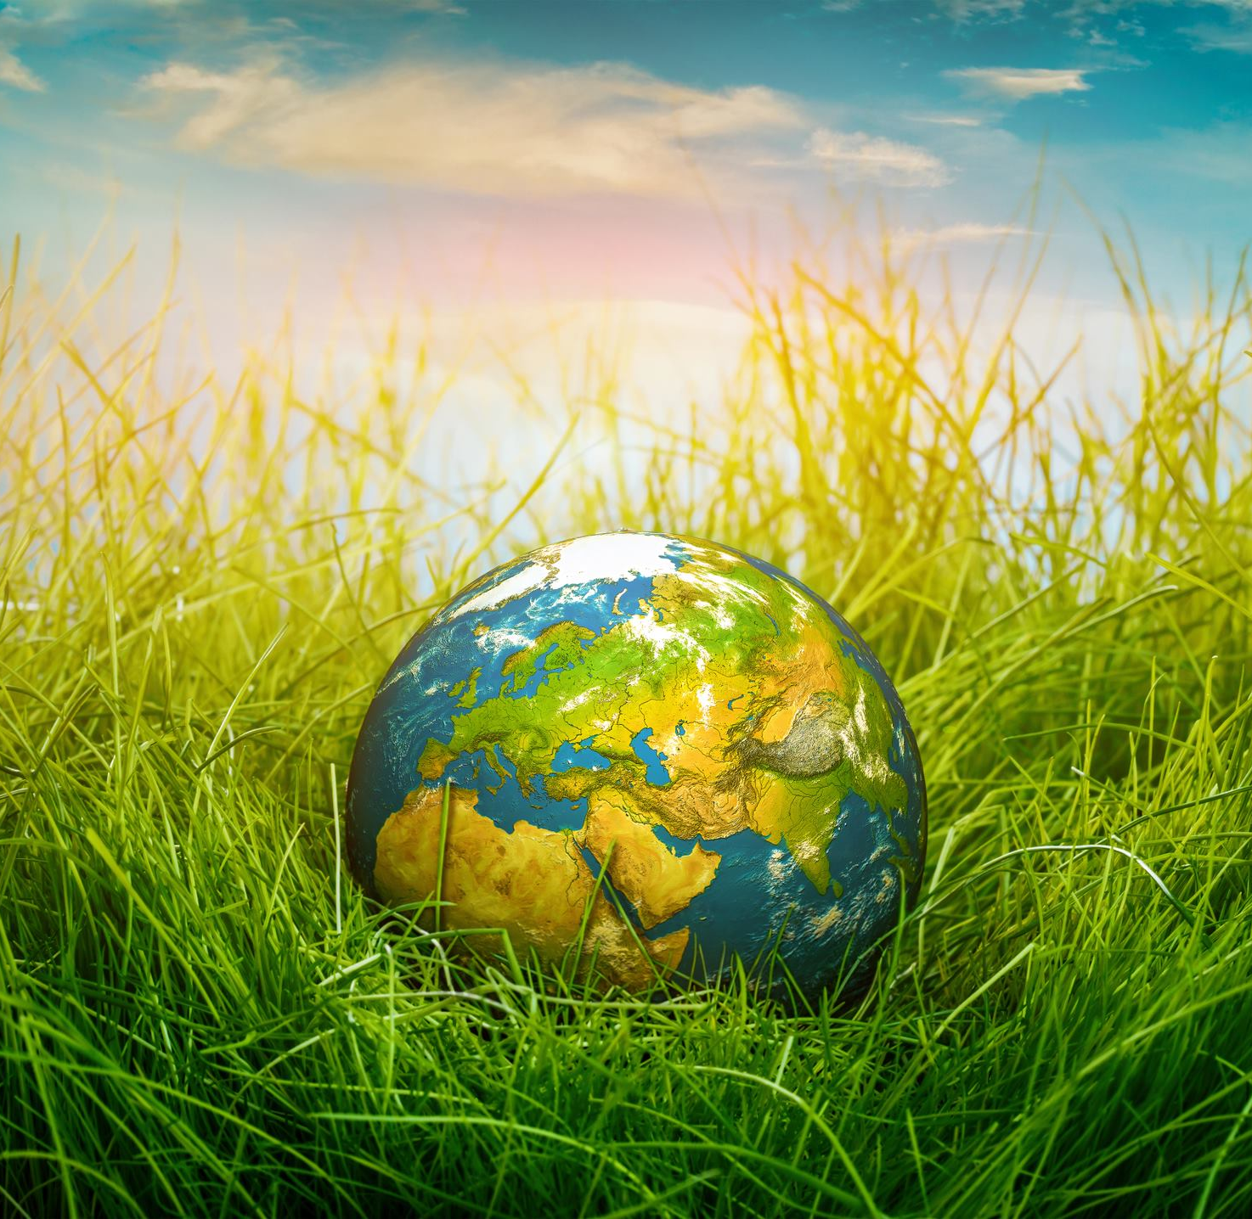
Our World
Poetry Competition

Slide 2
Write a Haiku
Write a haiku about our world
you can decide on what that means to you
Competition deadline:
FRIDAY 3RD July

Slide 3
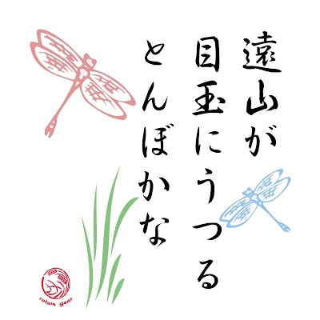
What is a haiku?
It is an ancient form of poetry that originated in Japan
It has a simple structure based on the number of syllables in each line (5,7,5)
Haikus are usually written about nature or one moment in time
They are rarely given titles

Slide 4
How to write a haiku

Slide 5
An example
Leaves shake in the wind
whispering, wandering, wild
until the silence.

Slide 6
An example
She sits quietly,
waiting for something to catch.
Never quick enough.

Slide 7
An example
Ask the protestors.
What do you hope to see next?
Peace for all on Earth.

Slide 8
How to get started
Decide on a topic
Make a list of words and images linked to your idea – you could use your journal
Start turning them into lines of poetry

Slide 9
Remember the rules!
A haiku is…
3 lines long
5 syllables
7 syllables
5 syllables
It doesn’t need a title

Slide 10
Our World
Poetry Competition

Slide 11
the | a | my | snail | wind | sun | clouds | sea
wild | bright | dark | brown | green | fast | waves | smooth
calm | Earth | trees | cat | blue | on | in | through
hedgehog | petals | flowers | blossom | window | moving | ocean | rabbits
sparkling | windy | happy | quickly | spiky | smiling | outside | under
jumping | turning | planet | thunderstorm | beautiful | animal | butterfly | whispering

